Slide 1




Symbiosis Institute of Technology
Home
Video
About Us
Contact
Abhishek Rajput 22070122007
Arnav Jain 22070122030
Atul Goyal 22070122039
Esha Sangra 22070122060
DEVOPS CA-2 IMPLEMENTATION
https://url-shortener-beige-phi.vercel.app
01

Slide 2



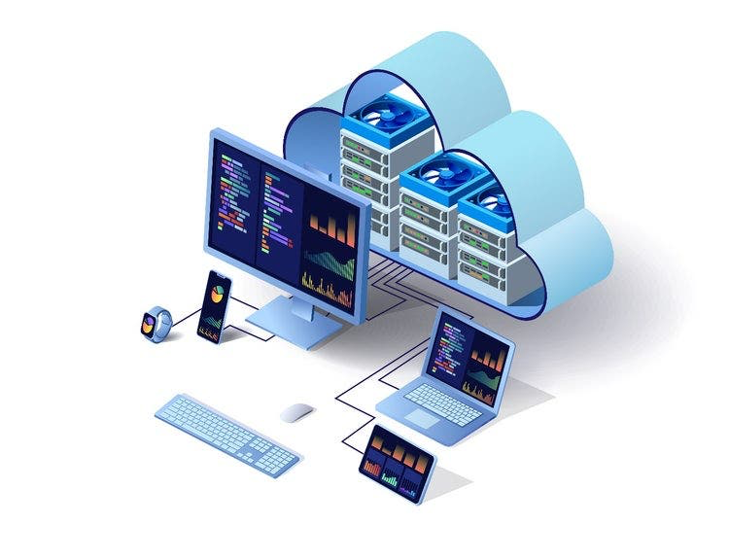
Home
Video
About Us
Contact
PROJECT OVERVIEW
Key Focus:
Deployment Strategy (CI/CD with Jenkins)
IaaC & Configuration Management (Terraform + Ansible)
Containerization & Orchestration (Docker + Kubernetes)
Monitoring & Logging (Prometheus + Grafana)
02

Slide 3
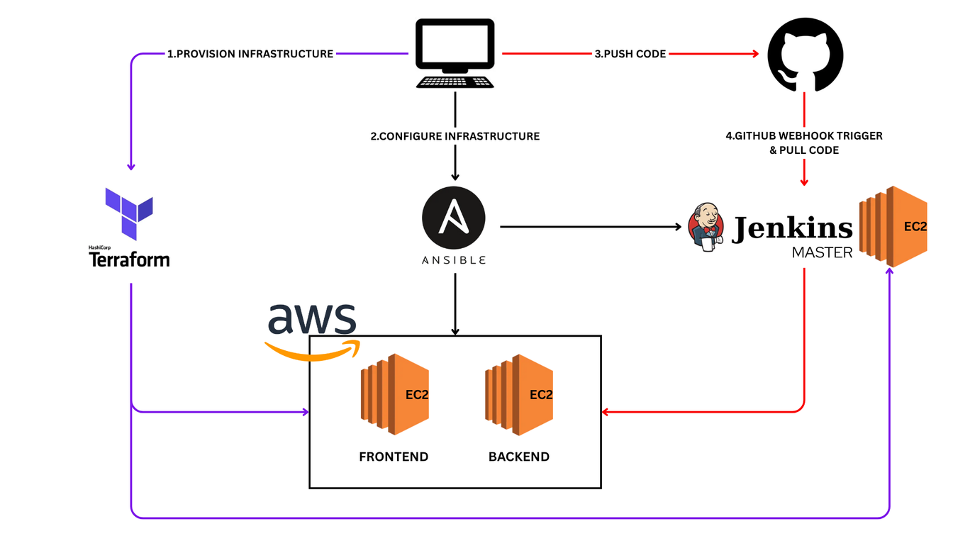
Home
Video
About Us
Contact
SETUP AND CONFIGURATION
Tools: Terraform + Ansible
Terraform: Provisions AWS EC2 infrastructure
Ansible: Configures runtime environment
Installs required packages (Kubernetes, Java, Docker)
Sets up users & permissions
Deploys application dependencies
03

Slide 4
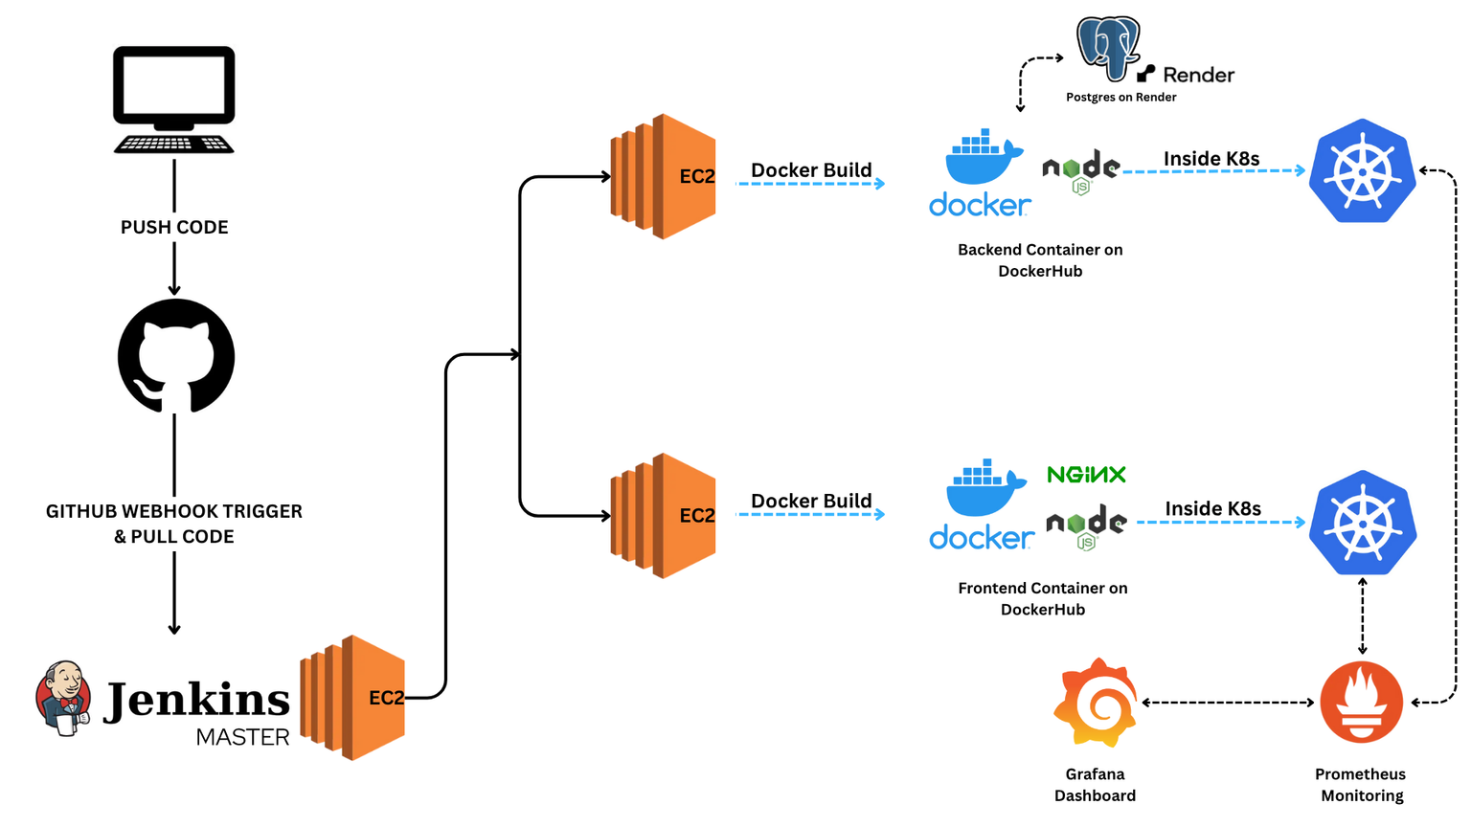
Home
Video
About Us
Contact
PIPELINE FLOW
04

Slide 5
OVERALL PIPELINE
Home
Video
About Us
Contact
Code Development & Version Control
Developers write and update Frontend (React/Angular) and Backend (SpringBoot).
Code is pushed to GitHub repository.
Continuous Integration (CI) – Jenkins
GitHub Webhook triggers Jenkins pipeline when code is pushed.
Jenkins stages:
Pull Code from GitHub.
Build & Test application.
Build Docker Images for frontend & backend.
Push Images to DockerHub.
Infrastructure as Code (IaC)
Terraform provisions AWS EC2 instances for:
Jenkins Master
Frontend Server
Backend Server
Ansible configures runtime environment:
Installs Java, Docker, Kubernetes.
Creates users, manages files.
Sets up dependencies for app execution.
05

Slide 6
OVERALL PIPELINE
Home
Video
About Us
Contact
Continuous Deployment (CD)
Jenkins deploys new Docker images onto AWS EC2.
Kubernetes Manifests (YAMLs):
Deployment.yaml (defines replicas, containers).
Service.yaml (exposes app internally or externally).
Rolling Updates ensure zero downtime.
Rollback if deployment fails.
Database Layer
Render’s PostgresSQl provides cloud-hosted DB for persistent storage.
Backend container connects securely to Render’s DB.
Monitoring & Logging
Prometheus scrapes application metrics (uptime, request latency, error rate).
Grafana visualizes data via dashboards.
Alerts are configured for failures or downtime.
Feedback Loop
Developers get instant feedback from Jenkins build logs & Grafana dashboards.
Errors fixed → code pushed again → pipeline automatically runs → new deployment.
06

Slide 7
Studio Shodwe
Home
Video
About Us
Contact
REFLECTION & CHALLENGES
Challenges:
Docker image compatibility
Kubernetes YAML troubleshooting
Grafana Dashboard Building
Lessons Learned:
IaC ensures reproducibility
CI/CD improves release speed
Monitoring helps reliability
07

Slide 8
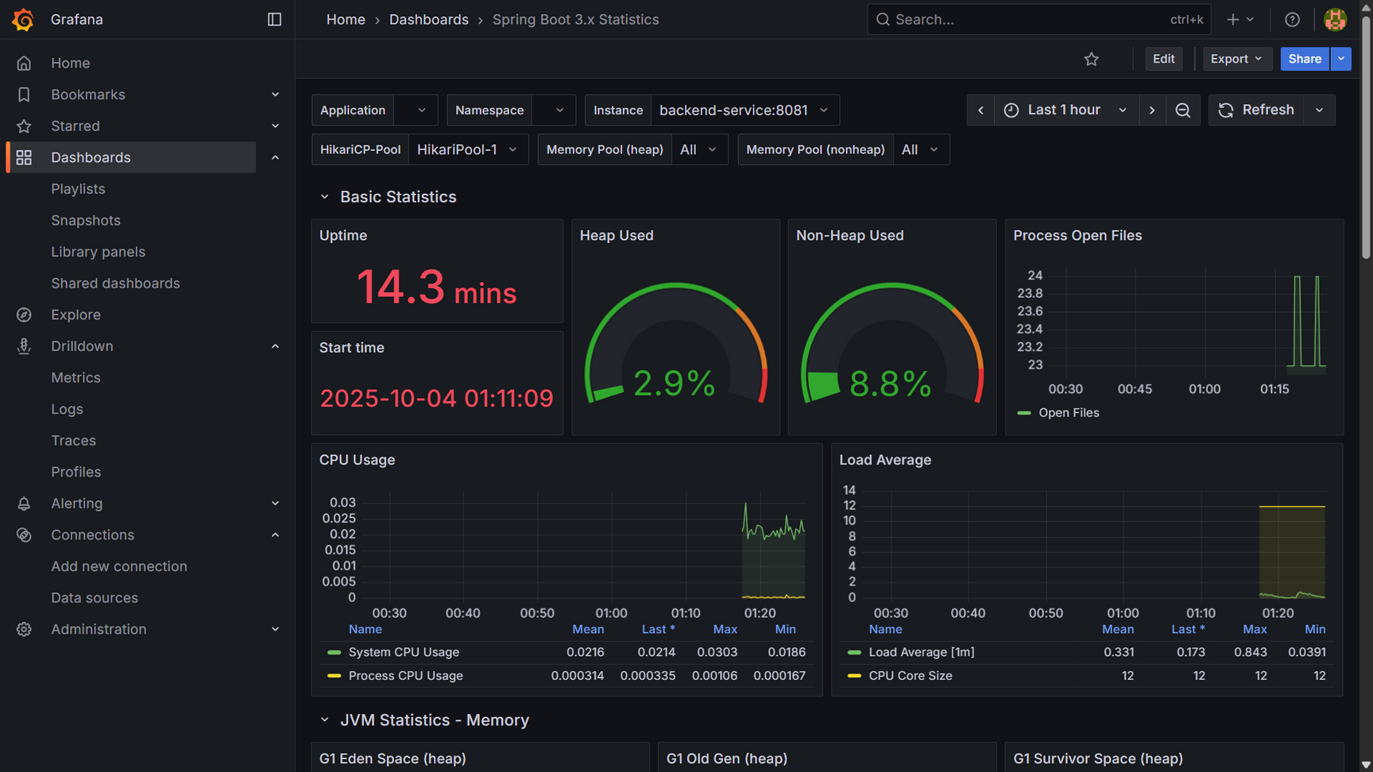
Home
Video
About Us
Contact
DASHBOARD
08

Slide 9

Symbiosis Institute of Technology
Home
Video
About Us
Contact
THANK
YOU
09

